Slide 1
To-Let
Submitted By:
Razki Rabbani Abtahi (201014105)
Hassan Ahmed Maruf (171014008)
Arpita Podder (201014062)
Tasnima Islam (201014039)

Slide 2

Login Screen:

Slide 3
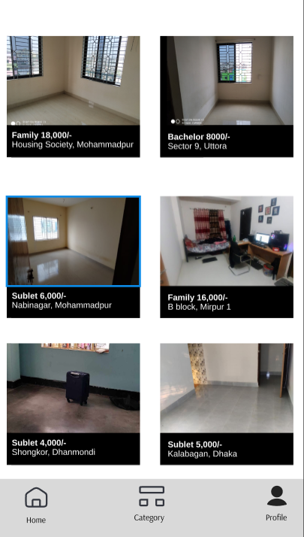
Homepage:

Slide 4
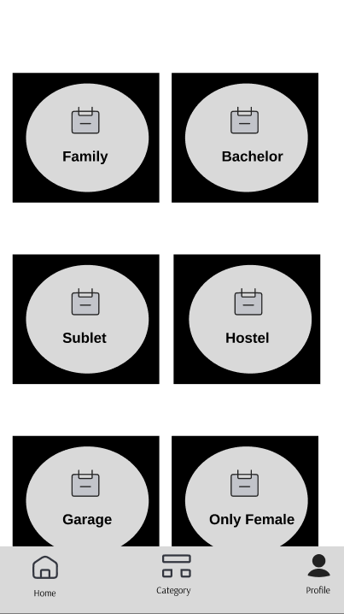
Category:

Slide 5
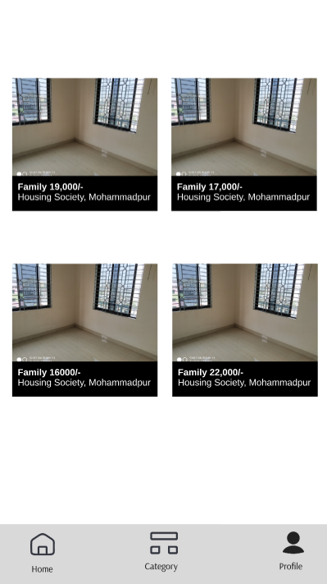
Family Category:

Slide 6
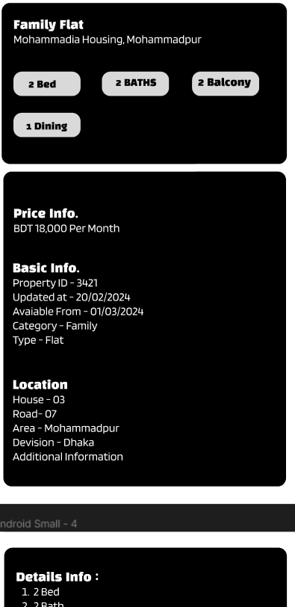
Details:

Slide 7
Thank You

